Slide 1
Robustness of oscillation in mammalian circadian clock
Xiangyu Yao, Group Meeting 6/25/2021

Slide 2
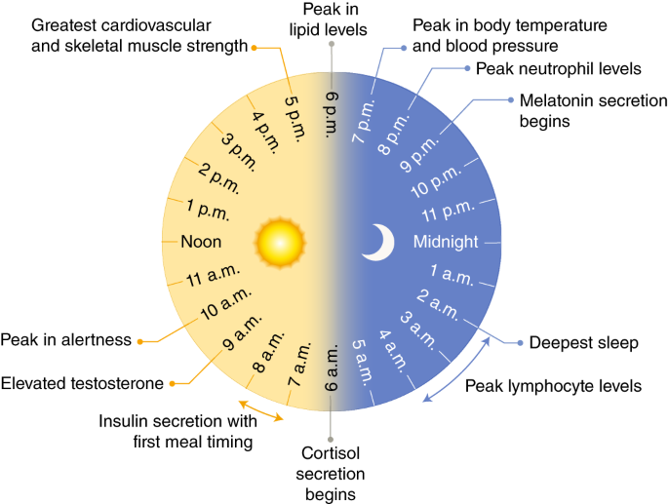
Circadian clock adjusts our body to the changing environment
Selma Masri et al. 2018

Slide 3
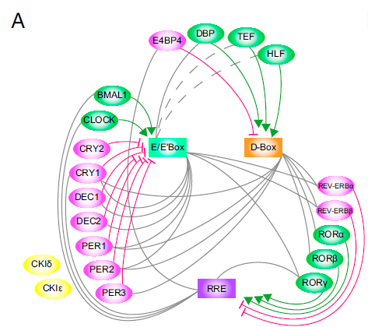
Promoting TF
Inhibiting TF
Core clock controlled elements
Narumi et al, 2016

Slide 4
Core and auxiliary feedback loops
CRY
CRY
PER
BMAL1
CLOCK
CRY
PER
BMAL1
CLOCK
Per mRNA
PER
E-box
BMAL1
CLOCK
BMAL1
CLOCK
E-box
ROR
REV-ERB
E-box
Bmal1 mRNA
BMAL1
RRE

Slide 5
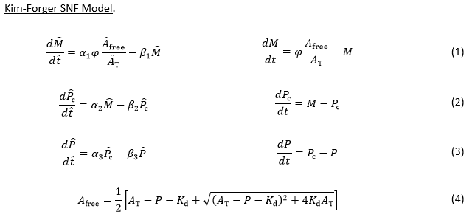
Mathematical models of the core clock

Slide 6
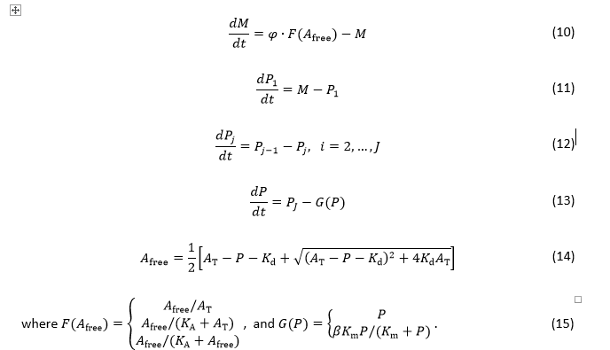
Modification of Kim-Forger model

Slide 7
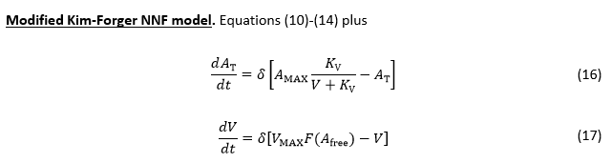
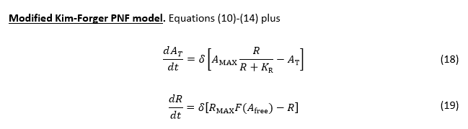
Addition of auxiliary loops

Slide 8
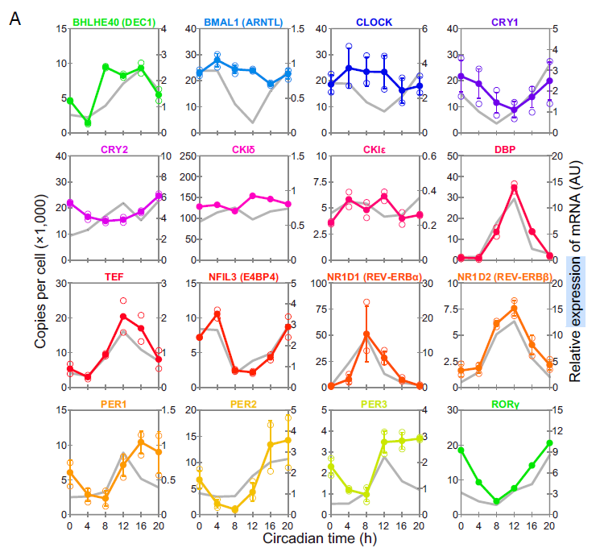
Relative amplitude of Bmal1 ~ 20%
Protein | Amount
BMAL1 | 25,000
PER | 30,000
REV-ERBα | 50,000
ROR | 20,000

Slide 9
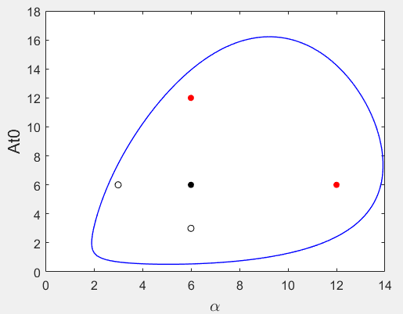
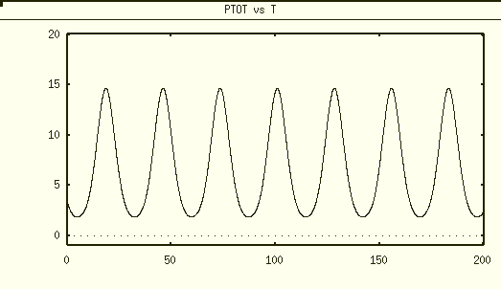
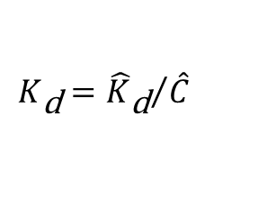

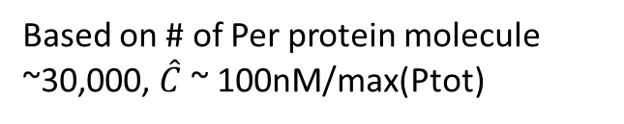
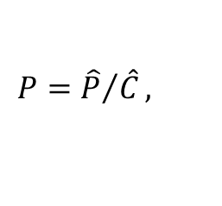
SNF 0M8
tetra x4
Parameter | Value
Kd | 0.3
At0 | 6
Alpha (fold-change of Per transcription) | 6
Vmax (MM degradation) | 1.3
Km | 1
Homo diploid x2
Dimensionless max(Ptot)= 15
$$P={\hat{P}}/{\hat{C}},$$
$$K_{\text{d}}={{\hat{K}}_{\text{d}}}/{\hat{C}}$$
Based on # of Per protein molecule ~30,000, $\hat{C}$ ~ 100nM/max(Ptot)
${\hat{K}}_{\text{d}}$ = 2 nM

Slide 10
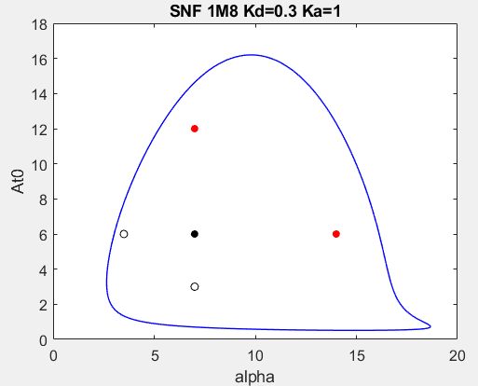

SNF 1M8
Parameter | Value
Kd | 0.3
At0 | 6
alpha | 7
Vmax (MM degradation) | 1.3
Km | 1
Ka | 1
${\hat{K}}_{\text{d}}$ = 2 nM

Slide 11
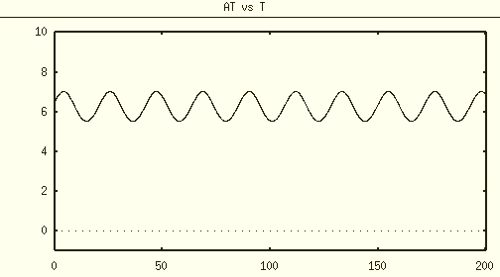
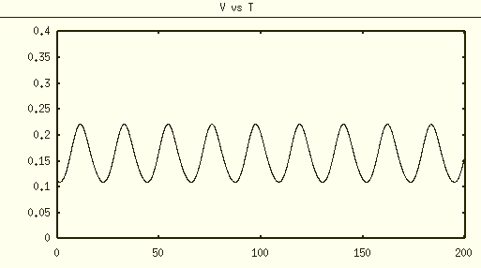
NNF 1M8
Parameter | Value
Kd | 0.3
alpha | 7
Vmax (MM degradation) | 1.3
Km | 1
Ka | 1
δ | 0.2
Vmax (max Rev) | 1
Amax | 16
Kv | 0.1
Relative amplitude ~ 10%

Slide 12
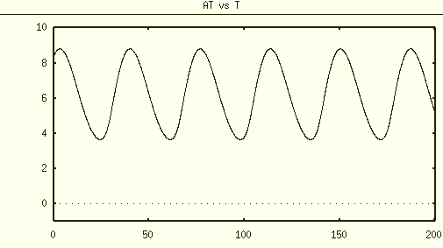
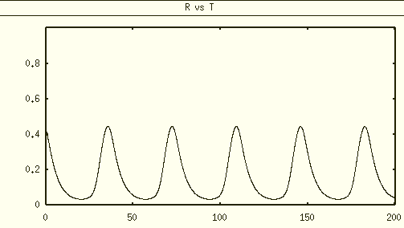
PNF 1M8
Parameter | Value
Kd | 0.3
At0 | 6
alpha | 7
Vmax (MM degradation) | 1.3
Km | 1
Ka | 1
δ | 0.2
Rmax | 1
Amax | 12
Kr | 0.1
Relative amplitude ~ 30%

Slide 13

Goal: Tune parameters Kv and Kr such that oscillation amplitude of Bmal1 in NNF and PNF are similar
At~6, Kd=0.3

Slide 14
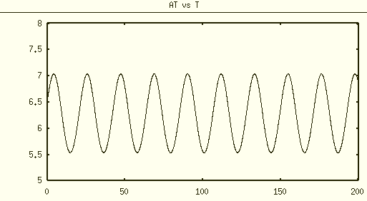
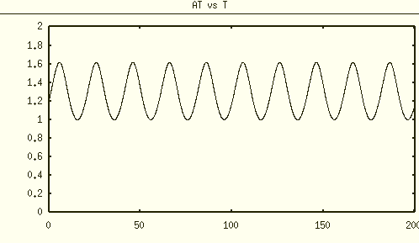
Tune Kv for NNF model
Relative amplitude ~ 12%
Relative amplitude ~ 26%
Kv=0.01
Kv=0.1

Slide 15
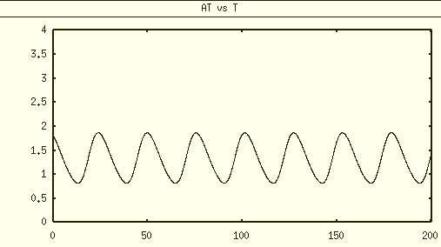
Tune Kr for PNF model
Relative amplitude ~ 37%
Relative amplitude ~ 36%
Kr=0.1
Kr=1

